Slide 1
Change is in the Air!
Market Update
Ben Vestal
Argus Self Storage Advisors
August 18, 2022

Slide 2

It’s Been a Long Run

Slide 3
Mid-Year Market Update
1
Market Fundamentals are Strong

Slide 4
1. Market Fundamentals are Strong
Source: Self-Storage Almanac 2022

Slide 5






1. Market Fundamentals are Strong
Portfolio Occupancy: Same Store
Source: MJ Partners

Slide 6
1. Market Fundamentals are Strong
Argus Broker Affiliate Local Market Observations
Larry Goldman, CCIM (AR): Market fundamentals continue to be strong throughout Arkansas. Values continue maintain historic highs, despite interest rate increases. The big news is that while Arkansas was not a draw to global investors prior to 2020, the Arkansas markets have become a significant targets as rate growth is strong, markets have historically fragmented ownership and operating expenses are relatively low.
Joan Lucas & Cole Carosella (CO): Leasing velocity remains strong and occupancies are still at all-time highs in the Rocky Mountain region. Operators are able to roll out significant rate increases, partially due to the slowing of new development, and are seeing robust year-over-year revenue growth. Deal flow in Colorado is still strong.
Tom Flannigan (MN): As we approach Memorial Day weekend, we are seeing a strong start to the self-storage rental season. Although rent rates haven’t been as strong in some pockets of the Twin Cities, most facilities are enjoying high occupancies which should allow for future rate increases. As an example, a local operator with a facility in lease-up recently commented that they have leased up over 4,500 SF in the last month.
Josh Koerner (FL): The Florida market continues to perform in every way. The majority of new lease-up projects are ahead of projections, rental rates across the state continue to increase, and occupancies continue to hold above 90% on average throughout the state.

Slide 7
1. Market Fundamentals are Strong
Source: Extra Space Storage

Slide 8
Mid-Year Market Update
1
Market Fundamentals are Strong
2
Capital Markets are Fluid, but Moving

Slide 9
2. Capital Markets are Fluid, but Moving
Treasury Interest Rate and Self-Storage Cap Rates 2002-2022
Year | 2002 | 2003 | 2004 | 2005 | 2006 | 2007 | 2008 | 2009 | 2010 | 2011 | 2012 | 2013 | 2014 | 2015 | 2016 | 2017 | 2018 | 2019 | 2020 | 2021 | Jan-Jun 2022 | Jul 22
10-Yr Treasury Interest Rate | 4.61 | 4.01 | 4.27 | 4.29 | 4.80 | 4.63 | 3.66 | 3.26 | 3.22 | 2.78 | 1.89 | 2.35 | 2.54 | 2.14 | 1.84 | 2.40 | 2.69 | 1.77 | 0.77 | 1.56 | 2.94 | 2.86
Avg Self Storage Cap Rate | 9.59 | 9.08 | 8.74 | 7.37 | 7.34 | 7.41 | 7.59 | 8.57 | 8.09 | 7.54 | 6.75 | 6.25 | 6.01 | 5.74 | 5.70 | 5.60 | 5.68 | 5.60 | 5.50 | 5.1 | 4.98 | 5.21
Spread | 4.98 | 5.07 | 4.47 | 3.08 | 2.54 | 2.78 | 3.93 | 5.31 | 4.87 | 4.76 | 4.86 | 3.90 | 3.47 | 3.60 | 3.86 | 3.20 | 2.99 | 3.83 | 4.73 | 3.54 | 2.04 | 2.35

Slide 10
2. Capital Markets are Fluid, but Moving

Slide 11
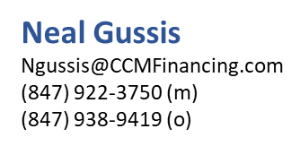
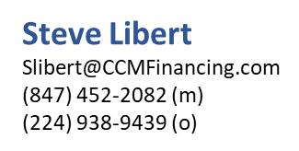
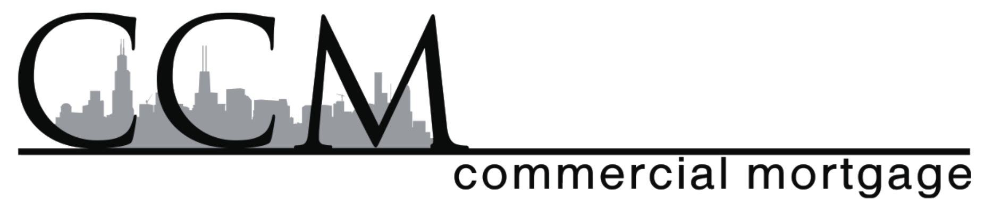
2. Capital Markets are Fluid, but Moving
Summary of Indices and Spreads
 | 1/1/2022 | 8/15/2022 | Increase | Permanent/Construction Spreads | Bridge Spreads | Interest Rates Today
Variable Rate (likely additional rate hikes near term)
Fed Fund Rate | 0.08% | 2.33% | 2.25%
Prime | 3.25% | 5.50% | 2.25% | -0.25 +2.0% |  | 5.25%-7.50%
BSBY – 1 month | 0.07% | 1.74% | 1.67% | 2.5%-4.0% | 3.5%+ | 4.25%-5.75%
SOFR – 1 month | 0.35% | 2.28% | 1.93% | 2.5%-4.0% | 3.5%+ | 4.75%-6.25%
LIBOR – 1 month | 0.10% | 2.38% | 2.28% | 2.5%-4.0% | 3.5%+ | 4.90%-6.40%
FHLB – 1 month | 0.31% | 2.50% | 2.19% | 1.75%-3.50% |  | 4.25%-6.00%
Fixed Rate
5 Year FHLB | 1.73% | 3.48% | 1.75% | 1.75%+2.75% |  | 5.25%-6.25%
5 Yr Treasury | 1.50% | 2.97% | 1.47% | 1.75%+3.0% |  | 4.75%-6.00%
10 Yr Treasury | 1.67% | 2.84% | 1.17% | 1.75%+3.0% |  | 4.60%-5.85%
10 Yr SOFR Swap (CMBS) | 2.74% | 2.60% | -0.14% | 2.75%+3.25% |  | 5.35%-5.85%

Slide 12
Mid-Year Market Update
1
Market Fundamentals are Strong
2
Capital Markets are Fluid, but Moving
3
Performance and Valuation are Peaking

Slide 13
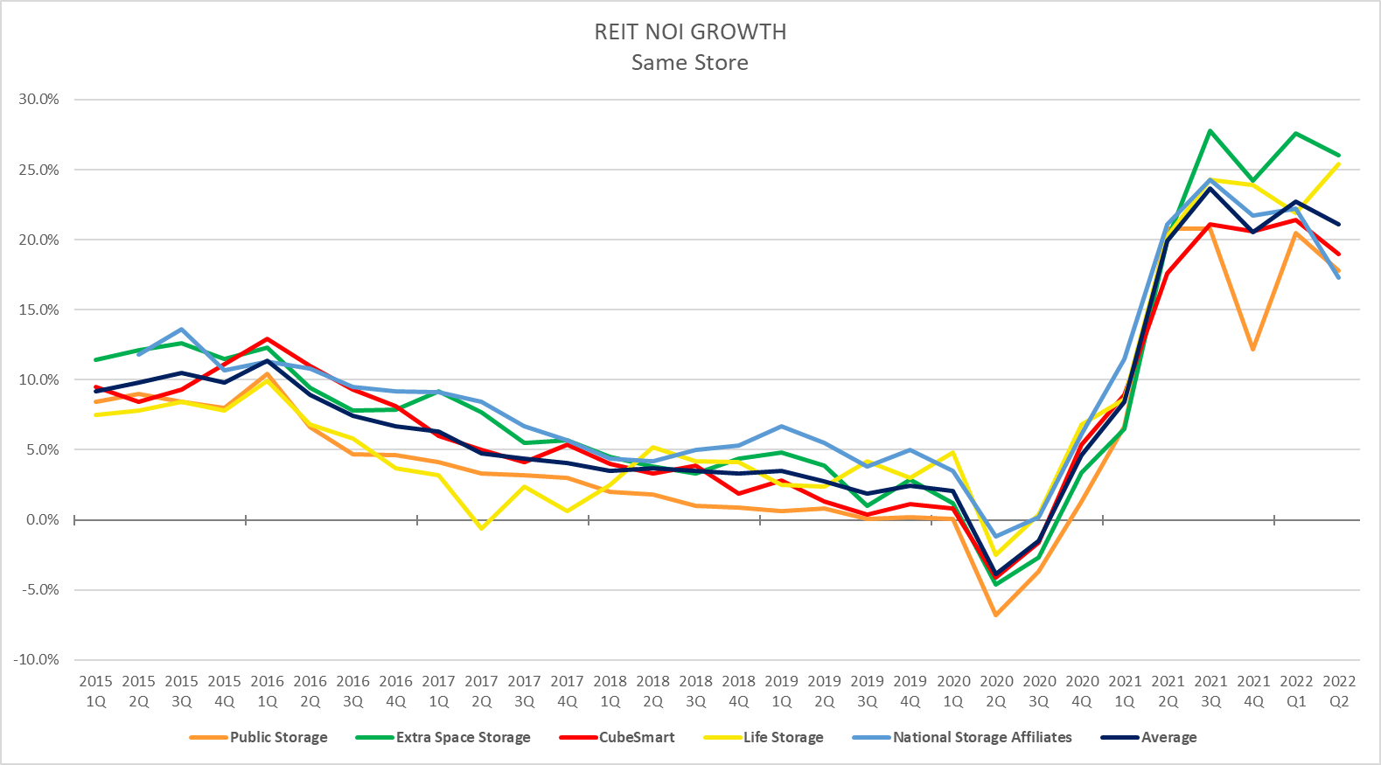
3. Performance and Valuation are
Peaking
Source: Company Earnings Reports

Slide 14
3. Performance and Valuation are Peaking
Treasury Interest Rate and Self-Storage Cap Rates 2002-2022
Year | 2002 | 2003 | 2004 | 2005 | 2006 | 2007 | 2008 | 2009 | 2010 | 2011 | 2012 | 2013 | 2014 | 2015 | 2016 | 2017 | 2018 | 2019 | 2020 | 2021 | Jan-Jun 2022 | Jul 22
10-Yr Treasury Interest Rate | 4.61 | 4.01 | 4.27 | 4.29 | 4.80 | 4.63 | 3.66 | 3.26 | 3.22 | 2.78 | 1.89 | 2.35 | 2.54 | 2.14 | 1.84 | 2.40 | 2.69 | 1.77 | 0.77 | 1.56 | 2.94 | 2.86
Avg Self Storage Cap Rate | 9.59 | 9.08 | 8.74 | 7.37 | 7.34 | 7.41 | 7.59 | 8.57 | 8.09 | 7.54 | 6.75 | 6.25 | 6.01 | 5.74 | 5.70 | 5.60 | 5.68 | 5.60 | 5.50 | 5.1 | 4.98 | 5.21
Spread | 4.98 | 5.07 | 4.47 | 3.08 | 2.54 | 2.78 | 3.93 | 5.31 | 4.87 | 4.76 | 4.86 | 3.90 | 3.47 | 3.60 | 3.86 | 3.20 | 2.99 | 3.83 | 4.73 | 3.54 | 2.04 | 2.35

Slide 15
3. Performance and Valuation are
Peaking
Source: NKF Valuation & CoStar

Slide 16
3. Performance and Valuation are
Peaking
Underwriting Assumptions
Valuation Assumptions
Revenue Growth Years 1-2 Years 3-5 | 7%-15% 3%-6%
Occupancy Years 1-2 Years 3-5 | 90%-92% 88%-92%
Lease Up Deals Year 1 Physical Occupancy Year 2 Physical Occupancy Year 3 Physical Occupancy | 40% 70% 90%
Operating Expense Real Estate Tax Other Expenses Operating Expense Ratio | Post-closing adjustment 1.5%-2.5% growth 32%-40%
Stabilized Assets | T-3 or T-6 Revenue T-12 Operating Expenses Year-1 ???
Lease Up Assets | 150-200 bps over stabilized market cap rate on Year 3 NOI
Debt Assumptions
Interest Rate | 4.75%-5.5%
Loan to Value | 60%-75%
Amortization | 25 yr/1-2 yrs IO
Cap Rates
Class A | 3.75%-5.25%
Class B | 4.25%-6.0%
Class C | 5.50%-7.5%

Slide 17
3. Performance and Valuation are
Peaking
Argus Broker Affiliate Local Market Observations
Larry Goldman, CCIM (AR): Despite pricing pressure driven by higher interest rates, values in Arkansas remain at historic highs. With the recent trend of new state buyers making significant investments in all corners of the state, cap rate spreads are getting compressed. It is likely a matter of time before interest rates push cap rates down, but in the meantime most facilities around the state are continuing to see improving performance, mostly through rate growth as occupancies have been high in recent years.
Bill Barnhill, CCIM & Stuart LaGroue (AL): Storage market performance is still robust due to actual and projected population growth along the Gulf Coast. While seller expectations may be evolving due to concerns about overbuilding and higher interest rates, there are still many investors desiring to own self-storage and valuations should remain strong.
Jared Jones, CCIM (OK): Sentiment in Oklahoma is still very strong and buyers can purchase here for a much lower price per pound than other markets, which creates a larger, non-institutional buyer pool. Occupancies for non-lease up properties are at peak and revenues are hitting records.
Chad Snyder & Tyler Trahant (TX): In North Texas we are not seeing the swift change to pricing expectations that other areas of the country might be experiencing. We are still seeing buyers close on deals at early 2022 pricing and many off market, all-cash transactions. Simply put, there is still great need and desire to place capital into cash flow producing assets like self-storage.

Slide 18
Mid-Year Market Update
1
Market Fundamentals are Strong
2
Capital Markets are Fluid, but Moving
3
Performance and Valuation are Peaking
4
The Development Wave is Slow in Coming

Slide 19
4. The Development Wave is Slow in Coming
Properties | 2017 | 2018 | 2019 | 2020 | 2021 | 2022 | Argus 2023 Forecast
New Build | 421 | 619 | 578 | 577 | 575 | 487 | 559
Conversion | 85 | 132 | 145 | 97 | 108 | 82 | 58
Expansion | 461 | 446 | 261 | 139 | 175 | 171 | 166
Total | 967 | 1,197 | 984 | 813 | 858 | 740 | 783
NRSF (millions) | 2017 | 2018 | 2019 | 2020 | 2021 | 2022 | Argus 2023 Forecast
New Build | 30 | 43 | 41 | 44 | 43 | 38 | 41
Conversion | 6 | 11 | 10 | 8 | 8 | 6 | 4
Expansion | 9 | 9 | 7 | 5 | 6 | 6 | 6
Total | 45 | 63 | 58 | 57 | 57 | 50 | 51
NRSF as % of Supply | 3.6% | 4.9% | 4.4% | 4.1% | 3.9% | 3.2% | 3.2%
Source: Yardi/Argus

Slide 20
Mid-Year Market Update
1
Market Fundamentals are Strong
2
Capital Markets are Fluid, but Moving
3
Performance and Valuation are Peaking
4
The Development Wave is Slow in Coming
5
Understanding the Real Estate Cycle

Slide 21
5. Understanding the Real Estate Cycle
Point of maximum financial risk
“Temporary setback. I’m a long-term investor.”
“Wow, I feel great about this investment.”
Euphoria
Thrill
Anxiety
Denial
Excitement
Fear
Optimism
2021
2022
Desperation
Optimism
2020
Panic
Point of maximum financial opportunity
Relief
How times have changed!
Capitulation
Hope
“Maybe the markets just aren’t for me.”
Despondency
Depression
Source: Denver Investment Advisors

Slide 22
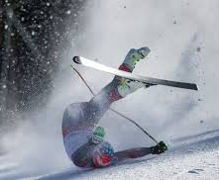
It’s Been a Long Run

Slide 23
Tax Strategies
1031 Exchange
What: Tax deferred transaction where seller transfers Net Sales Proceeds (NSP) of relinquished property into one or several replacement properties of like kind nature
Why: For investors seeking to defer Capital Gains taxes and Depreciation Recapture taxes of relinquished property.
721 Exchange
What: A tax deferment strategy in which sellers can transfer property to an umbrella partnership in exchange for partnership units. The umbrella partnership is a subsidiary of the public REIT.
Why: Capital Gains tax deferral, appreciation, depreciation tax shelter, debt pay down. Low stress, good return investment with reduced risk by diversification.
Delaware Statutory Trust
What: A Delaware Statutory Trust is a legal entity formed under Delaware law that allows investors to own undivided fractional ownership interests in professionally managed institutional grade real estate offerings around the United States.
Why: The IRS recognized DSTs as “replacement property” for 1031 exchange purposes. Thus, the purchase of an ownership interest in a DST is treated as a direct investment/interest in real estate. A DST can offer investors highly tax-favored treatment in regard to monthly distributions due to the nature of the unit investment trust.
This information contained herein is a general summary, is for informational purposes only and may not be relied upon for any purpose, including in connection with the purchase or sale of any security or property. Nothing contained herein should be construed as legal, business, tax or accounting advice. You should consult your own attorney, business advisor, tax advisor and accounting advisor as to legal, business, tax, accounting and related matters concerning any of the transactions described herein.

Slide 24
Market Predictions - Q3/Q4 2022
Self-storage NOI growth will increase, but at a slower pace
The lending market will be fluid and aggressive – rates will rise slightly or flatten in Q3 & Q4 2022
Construction loans will become more available and aggressive
Physical occupancies will stabilize and start to flatten
Rental rates will increase 10%-12%
Transaction velocity will continue to be robust. One to five property deals will dominate the transaction market
Market fundamentals will remain strong but customer pricing fatigue will set in. ECRI will be moderate in 2023!
Secondary markets will outperform on a % basis! And major MSAs will start to rebound!
Cap rates for CORE major MSAs will remain low and suburban and secondary cap rates will rise 25-35 basis points.
Covid concerns will continue to fade away
We will see several large private ownership groups explore going public. I believe we will see 1 or 2 new publicly traded REITS in the next 1-3 years.
Self-storage assets will continue to achieve CORE asset pricing

Slide 25
Questions?
Ben Vestal
President & CEO
Argus Self Storage Advisors
303-317-6469
bvestal@argus-realestate.com
www.argus-selfstorage.com
Self Storage Advisors

